Slide 1
Virtual
Town
Hall
The Scariest Word of All…Audit.
But is it really?
Xcalibur Town Hall
October 7, 2022
Recordings and notes housed at https://xcalibur.freshdesk.com/support/solutions

Slide 2
Nuts and Bolts
As you enter, you will be muted.
Please remain on mute until you are ready to speak.
If you have the capacity to and feel comfortable, please turn on your camera.
Don’t forget about the chat features of Zoom.
You can send private messages to other members of the meeting, or you can send group messages.
Xcalibur fosters understanding using data among educational professionals to empower students in becoming college and career ready.
Notes:
Missy

Slide 3
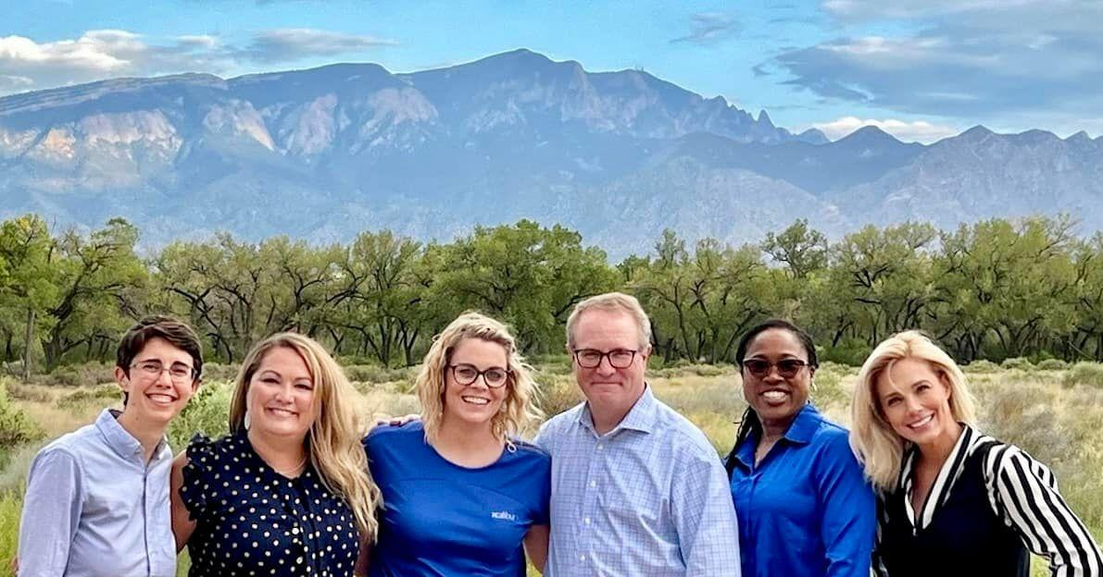
Xcalibur Team
Nelson Epifanio
Product Development
Scott Hollinger
Product Development & Network Support
Curt Reese
Director of Technology
Catherine Villnave
Julie Jaramillo
Aly
Cropley
Jim
Brown
Comfort
Afolabi
Missy
Gattuso
Notes:
Missy

Slide 4
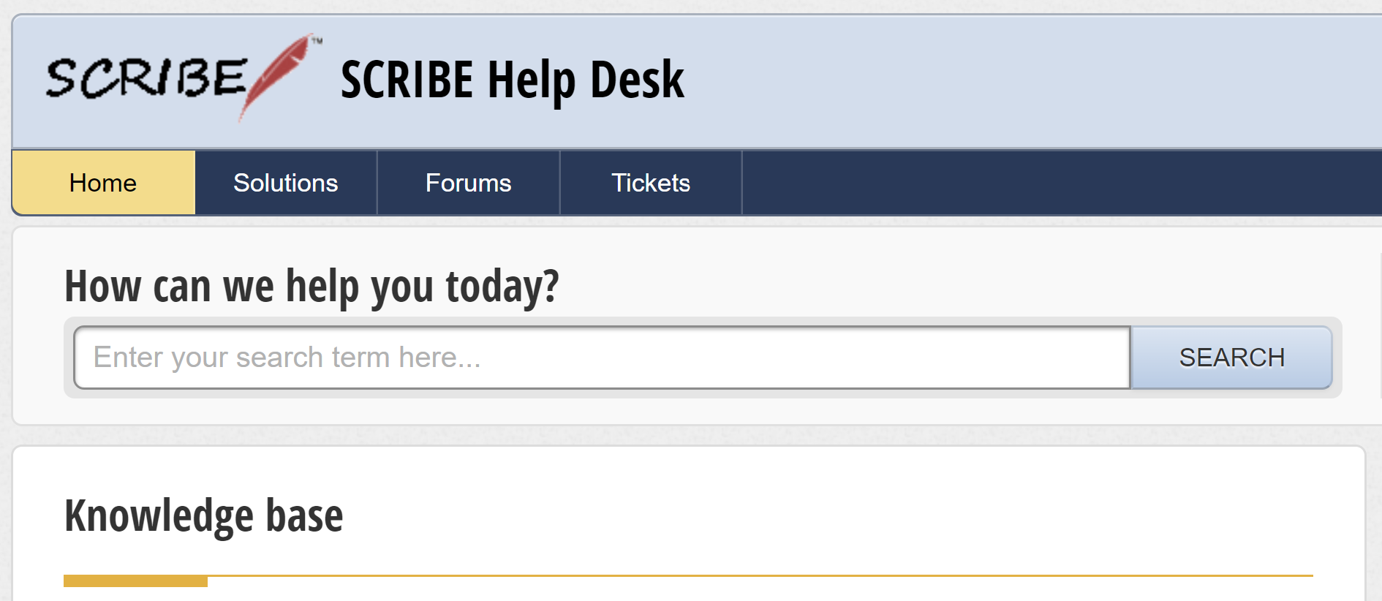
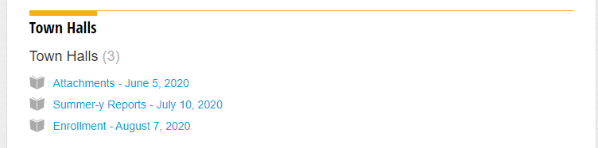
Resources
Town Hall video recording, powerpoint & notes on the Help Desk
Town Halls folder
Xcalibur fosters understanding using data among educational professionals to empower students in becoming college and career ready.
Notes:
Aly Cropley
https://xcalibur.freshdesk.com/en/support/solutions/folders/4000033055- town hall folder

Slide 5
Icebreaker
What scares you
(other than audits)?
Using the chat, let us know if you or anyone you know has any phobias.
Xcalibur fosters understanding using data among educational professionals to empower students in becoming college and career ready.
Notes:
Missy: (5 Minutes)

Slide 6
PSE Definition
What is a Data Audit?
A data audit is the assessment of data for quality throughout its lifecycle to ensure its accuracy and efficacy for its specific usage.
Identifies data issues - inaccurate and/or incomplete
Identifies data security gaps
Reference: https://www.egnyte.com/guides/governance/data-auditing
Xcalibur fosters understanding using data among educational professionals to empower students in becoming college and career ready.
Notes:
Comfort (10 mins): Who is doing the audit?
Periodic review of your documentation and processes.

Slide 7
PSE Definition
Benefits of a Data Audit?
Reporting/
Evaluation
Data Quality
Compliance
Xcalibur fosters understanding using data among educational professionals to empower students in becoming college and career ready.
Notes:
Comfort (less than 10 mins): Who is doing the audit?

Slide 8
PSE Definition
Who Does the Data Audit?
Funding Agency
Fiscal Agent
Xcalibur - Accountability partner
Data Steward/Owner
Xcalibur fosters understanding using data among educational professionals to empower students in becoming college and career ready.
Notes:
Comfort (less than 10 mins): Who is doing the audit?

Slide 9
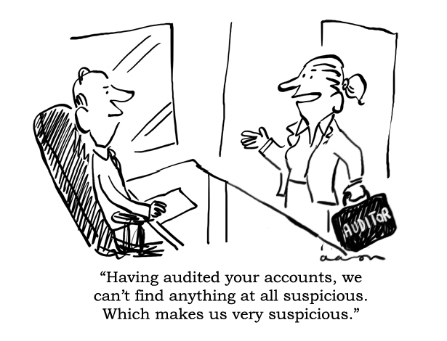
Cartoons
Xcalibur fosters understanding using data among educational professionals to empower students in becoming college and career ready.
Notes:
Share the findings from your internal audit with the rest of the

Slide 10
Why Audit Proof?
Xcalibur fosters understanding using data among educational professionals to empower students in becoming college and career ready.
Notes:
Catherine: Answer question in the cha (10-15 mins)t. Collect and fill in what is missing:
Easy answers
Don’t want to lose your job
Don’t want to lose your grant
Don’t want to be embarrassed
Deeper answers
Catch mistakes early so your data is a more accurate description of what is happening
Make data entry activities more efficient, so you don’t waste time on plugging data holes, hunting down data sources, or correcting lots of data
Ensure bad data processes doesn’t impact student programming
Make seamless transitions between staff
Story of my first data audit and Jose to Jazmyn

Slide 11
PSE Definition
Audit Proofing
Xcalibur fosters understanding using data among educational professionals to empower students in becoming college and career ready.
Notes:
Catherine: Answer question in the chat. Collect and fill in what is missing:
Easy answers
Don’t want to lose your job
Don’t want to lose your grant
Don’t want to be embarrassed
Deeper answers
Catch mistakes early so your data is a more accurate description of what is happening
Make data entry activities more efficient, so you don’t waste time on plugging data holes, hunting down data sources, or correcting lots of data
Ensure bad data processes doesn’t impact student programming
Make seamless transitions between staff
Story of my first data audit and Jose to Jazmyn

Slide 12
Poll Question
Xcalibur fosters understanding using data among educational professionals to empower students in becoming college and career ready.
Notes:
Catherine:What measures do you take to audit proof your grant? Check all that apply.
Regularly scheduled data review meetings
Data File Submission Trackers
Service and Participation Data Collection Trackers
Data Entry Trackers
Spot Checks
Process Maps
Internal Data Audits
External Data Audits
Documentation Organization (i.e. Attachments in Scribe)
Eek! None of these

Slide 13
PSE Definition
Audit Proofing
Regularly Scheduled Data Review Meetings
Process Maps
Trackers
Document Organization
Spot Checks
Practice Data Audits
Xcalibur fosters understanding using data among educational professionals to empower students in becoming college and career ready.
Notes:
Catherine: For each topic: name, describe the what, ask participants for benefits and challenges. Fill in if needed or no one shares.
Regularly Scheduled Data Review Meetings
What: standing meeting to review data and processes to determine challenges and successes
Benefits:
Data stays in the conversation
Challenges:
Finding time on everyone’s calendars
Process Maps
What: a chart or map that clearly describes who does what and when for specific data processes
Benefits:
Can diagnose breakdowns in collecting data
Can help with sustaining processes during staff turnover
Challenges:
Needs buy in from all people involved in the process
Can be challenging to get the map right
Has to be taught and implementation monitored
Trackers
What: excel spread sheets with columns to track the completion of different steps in a process – could be a tracker for data submission, data collection, data entry, etc.
Benefits:
Ensures no balls are dropped
Can also be good raw data to analyze
Challenges:
Requires diligent use
Only useful if used
Document organization
What: have a system in place that organizes the documentation associated with your data
Benefits:
Essential for an audit
Better system = less time spent on solving data errors
Challenges:
Time consuming to compile
Can be complex to organize
Question: do you keep hard copies or soft copies or both?
Note that Scribe offers many levels of attachments to organize documents on a variety of levels like student, school, and service
Spot checks
What: Internal audit of a certain percentage of a certain data set (i.e. spot check 10% of services entered in a month or 20% of student enrollment forms)
Benefits:
Encourage compliance from other grant staff
Can uncover a data hole
Challenges:
May miss findings
May encourage compliance of only what you are checking
Data Audits
What: simulate a data audit done by internal staff or by an outside source
Benefits:
Boost your confidence or uncover problems
Fix problems ahead of time
Challenges:
Time Consuming
Cost money
Mention that this is one offering of Xcalibur

Slide 14
Poll Question
Xcalibur fosters understanding using data among educational professionals to empower students in becoming college and career ready.
Notes:
Missy: What is the first thing you would do after an audit?
Look for a new job
Review the audit findings individually
Schedule a meeting to review the findings as a team
Take a vacation day

Slide 15
PSE Definition
After the Audit
Reflect on the usefulness of the audit
Review the findings
Use open communication to understand the findings
Correct mistakes
Review processes
Set a goal
Implement changes
Xcalibur fosters understanding using data among educational professionals to empower students in becoming college and career ready.
Notes:
Missy:
Corrections: What can and cannot be corrected? What should be fixed? Now, correct past or moving forward?
Timeline

Slide 16
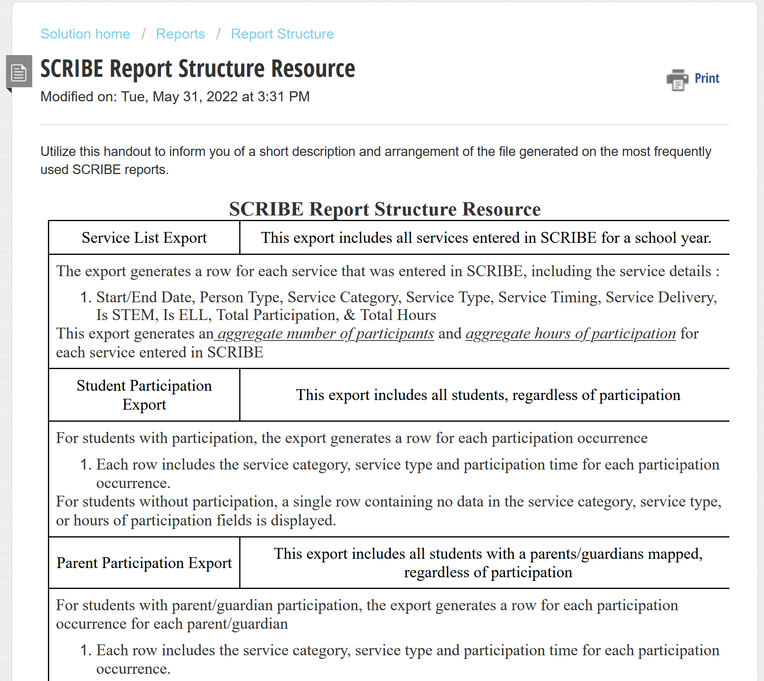
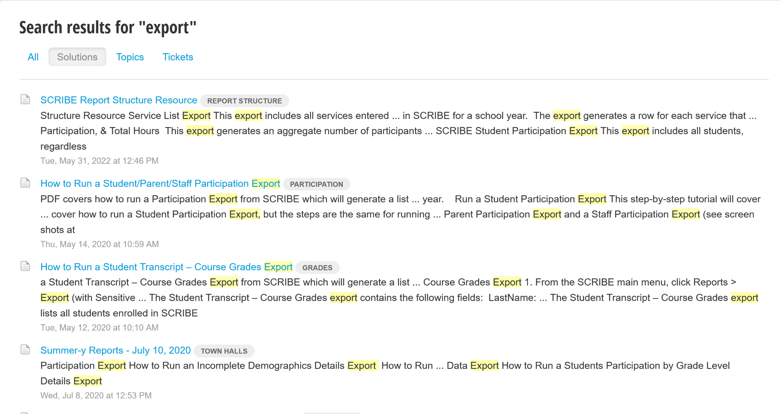
Snippet: SCRIBE Resources
Xcalibur fosters understanding using data among educational professionals to empower students in becoming college and career ready.
Notes:
Aly

Slide 17
Snippet: SCRIBE Resources - Training
TRAINING OPPORTUNITY!!!
Xcalibur fosters understanding using data among educational professionals to empower students in becoming college and career ready.
Notes:
Aly

Slide 18
Submitting a Topic
Topics for discussion and the SCRIBE snippet come from our community.
Use the link below to submit a discussion topic and/or a SCRIBE snippet topic for an upcoming town hall.
https://tinyurl.com/TownHallTopicSubmission
Xcalibur fosters understanding using data among educational professionals to empower students in becoming college and career ready.
Notes:
Missy:
https://tinyurl.com/TownHallTopicSubmission

Slide 19
Thank you for attending!
Register now for our November Town Hall - November 4th
https://bit.ly/November-TH
@SCRIBEforGEARUP
XcaliburSCRIBE
Xcalibur fosters understanding using data among educational professionals to empower students in becoming college and career ready.
Notes:
Missy

